Slide 1
DeepCoordiNet
Find out your Fashion Rating
OSS Team 10
김민석 박지원
임채진 장윤희

Slide 2
About our Project
01
Team Introduction
Who we are
02
Project Goal
What we are going to do
03
OSS
OSS we will use – DeepFasion2
04
Plan
Our plans to achieve our goal

Slide 3

Team Introduction
Who we are

Slide 4

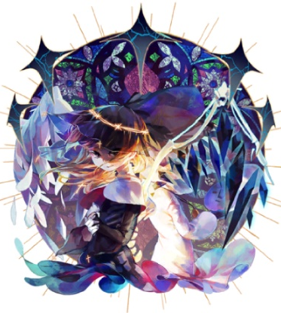


OSS Team 10
김민석
박지원
임채진
장윤희
2018312672
2018312734
2018311630
Developer
GitHub Manager
Analize Result
Coding
Data Crawling
Coding
Presentation
Analyze Result
GitHub Page
Data Crawling
GitHub Page
Presentation

Slide 5
Project Goal
What we are going to do

Slide 6
DeepCoordiNet
What is my
Fasion Rating?
Find out your Fashion Rating with
DeepCoordiNet
Insert a picture of your OOTD
Get the result of your rating
We will use information based on
More than 40,000 of models’ outfits

Slide 7
OSS
OSS we will use – DeepFashion2

Slide 8
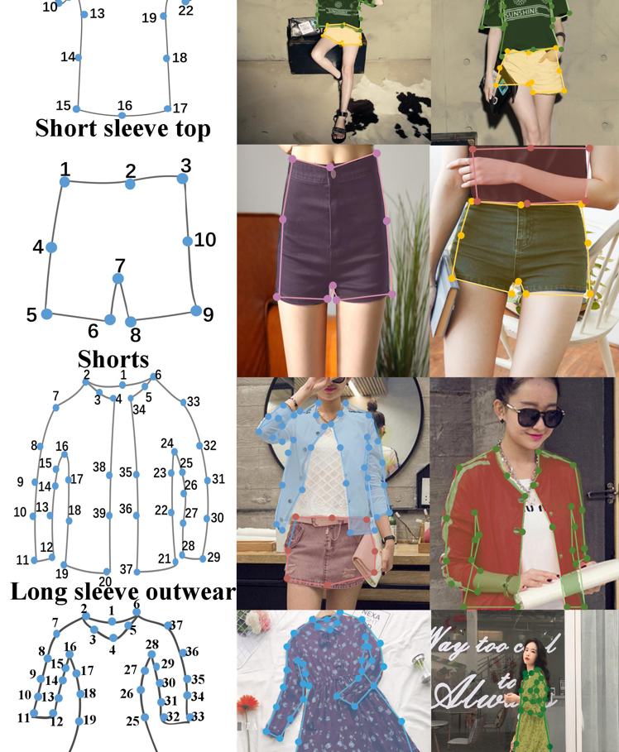
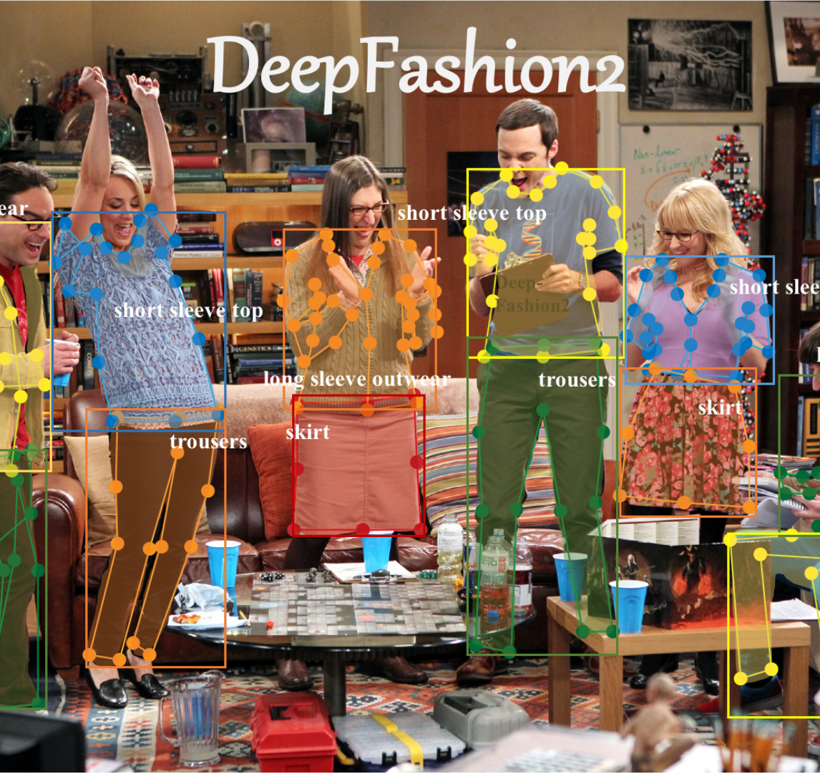
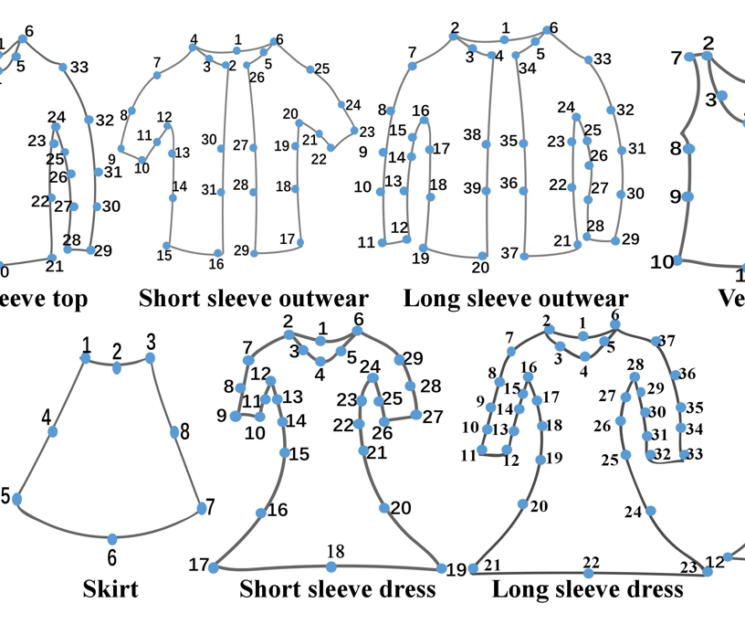
OSS
DeepFashion2
Open Source Software API
DeepCoordiNet
that is available on GitHub
Uses machine learning to
Analyze pictures of clothes
Input is a dataset of pictures
Resulting in an output of the
Types and Colors of clothes

Slide 9
Plan
Our plans to achieve our goal

Slide 10
Our Plan
01
Prepare Dataset
02
Run Machine Learning Code
Training Dataset: MUSINSA staff snap ‘16~’19
Test Dataset: CCP (Clothing Co-Parsing) Dataset
Modify DeepFasion2 API into needed form of machine learning code
Run using Training Dataset
03
Test and Analyze
04
GitHub Page & Presentation
Test using Test Dataset
Analyze results and examine accuracy
Inform progresses and results by
GitHub Page and Presentation

Slide 11

Thank You
OSS Team 10
DeepCoordiNet

